Slide 1


Project Phase 01
PARALLEL ALGORITHM FOR INDEPENDENT SPANNING TREES IN BUBBLE-SORT NETWORKS
Parallel and Distributed Computing (PDC)
Presented by Waseem And Asad | 20 APRIL 2025 | Instructor: Sir Farukh Bashir

Slide 2
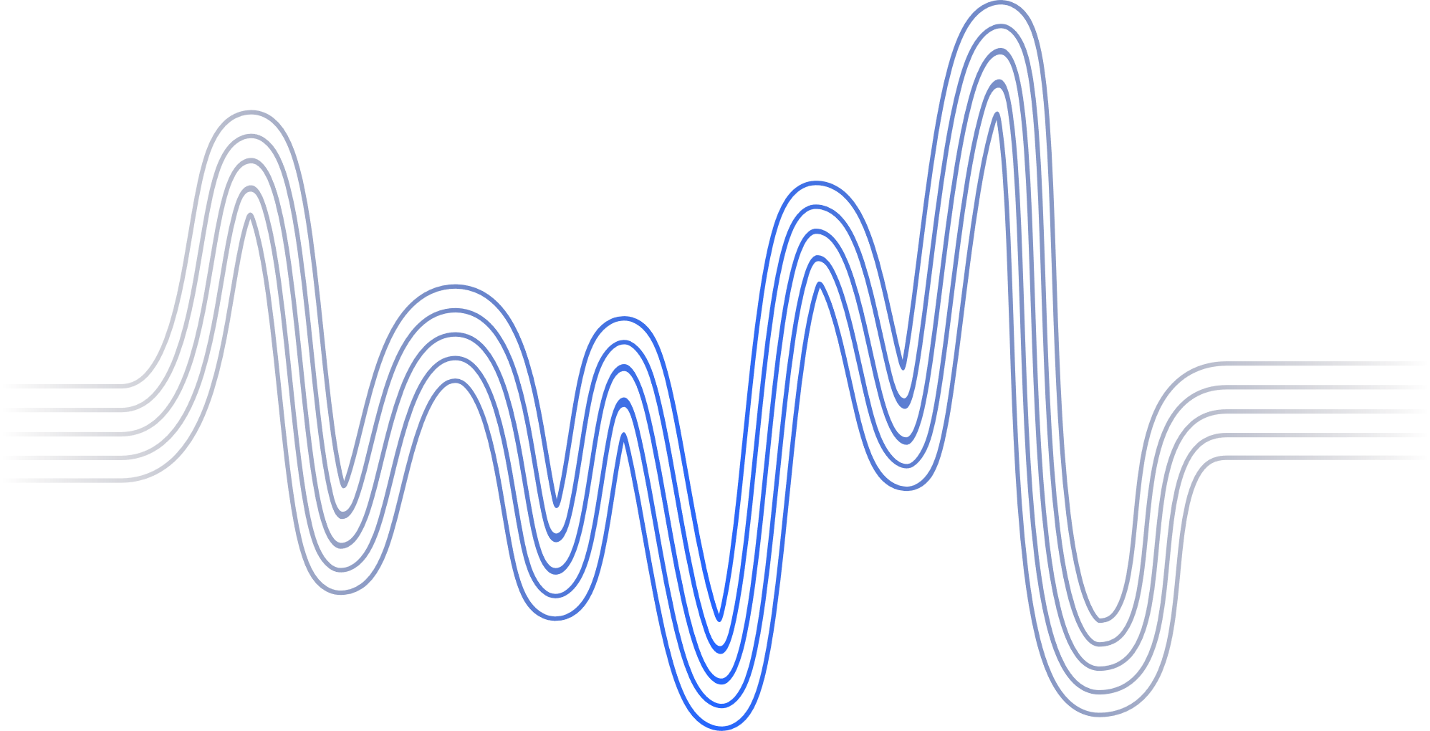
AGENDA
INTRODUCTION
BACKGROUND OF STUDY
PROBLEM STATEMENT
PAPER SOLUTION
IMPLEMENTATION
RESULTS AND ANALYSIS
CONCLUSION
We willl discuss these points in the nex diffrenett sections about our selected paper.

Slide 3

Project Phase 01
Back to Agenda
INTRODUCTION
ISTs help in secure & fault-tolerant data broadcasting.
Kao et al. (2019) used a recursive method for ISTs in Bubble-Sort Networks (Bn).
Recursive method is hard to parallelize.
This paper gives a non-recursive, parallelizable solution.
Each node finds parent in constant time.
Solves open problem from Kao et al.
Time complexity: O(n·n!) – optimal

Slide 4
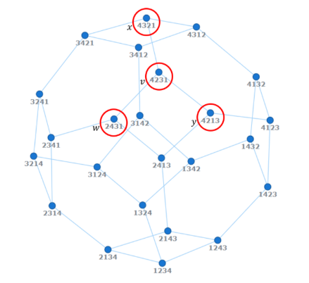

Project Phase 01
Background
of the Study
Sequence Analysis: Represents permutations of digits 1-4, tracking transitions between states.
Algorithm Visualization: Likely illustrates steps in a sorting algorithm (e.g., bubble or insertion sort).
Pattern Identification: Shows recurring sequences (e.g., 3241 repeated) and progression toward sorted order (1234).
Error/Backtracking Clues: Deviations (e.g., 1233) hint at potential errors or intermediate steps in a process.
Combinatorial Study: Demonstrates systematic exploration of permutations for research or educational purposes.
The bubble-sort network B4. The vertex v = 4231 has three adjacent vertices
w = 2431, x = 4321 and y = 4213.
Back to Agenda

Slide 5



Problem Statement
SCOPE OF THE STUDY | Constructing multiple Independent Spanning Trees (ISTs) in bubble-sort networks for fault-tolerant and secure data transmission.
RELEVANCE OF THE STUDY | ISTs enhance network reliability and security, but existing recursive algorithms are not parallelizable, limiting scalability.
RESEARCH QUESTIONS | Can a non-recursive, fully parallelizable algorithm for ISTs in bubble-sort networks achieve optimal time complexity?
Back to Agenda

Slide 6

PAPER SOLUTION
 | Non-recursive design: Avoids recursion, enabling full parallelization. Constant-time parent determination: Each vertex computes its parent in ISTs in O(1) time. Asymptotically optimal complexity: Total time O(n·n!) matches the theoretical lower bound. Vertex-transitive approach: Leverages symmetry in bubble-sort networks for uniform tree construction. Open problem resolution: Addresses the parallelization challenge posed by prior work (Kao et al., 2019).
Back to Agenda

Slide 7
Constructed n–1 independent spanning trees in Bn using a parallel algorithm.
Each vertex finds its parent in constant time.
Avoided recursion with a simple swap-based strategy.
Achieved O(n·n!) optimal time complexity.
Ensures disjoint paths for fault tolerance and secure communication.
Project Phase 01
Back to Agenda
IMPLEMENTATION

Slide 8
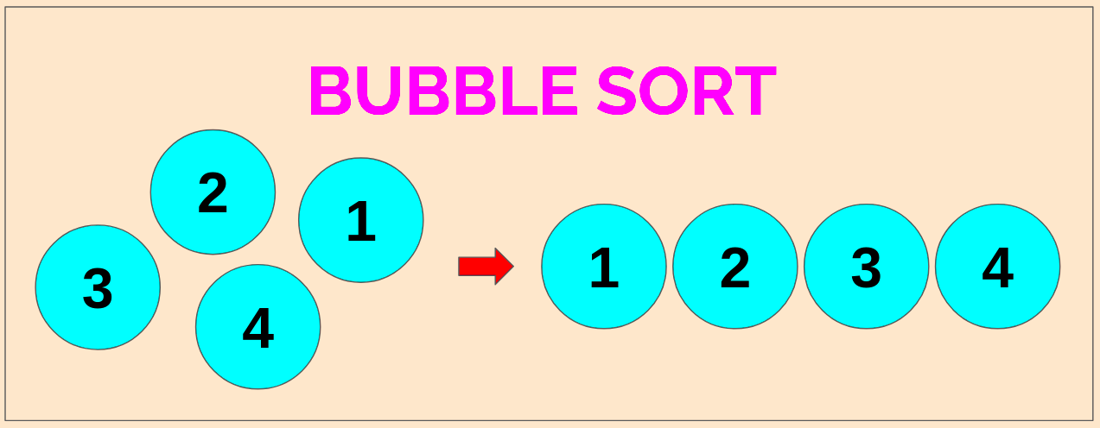
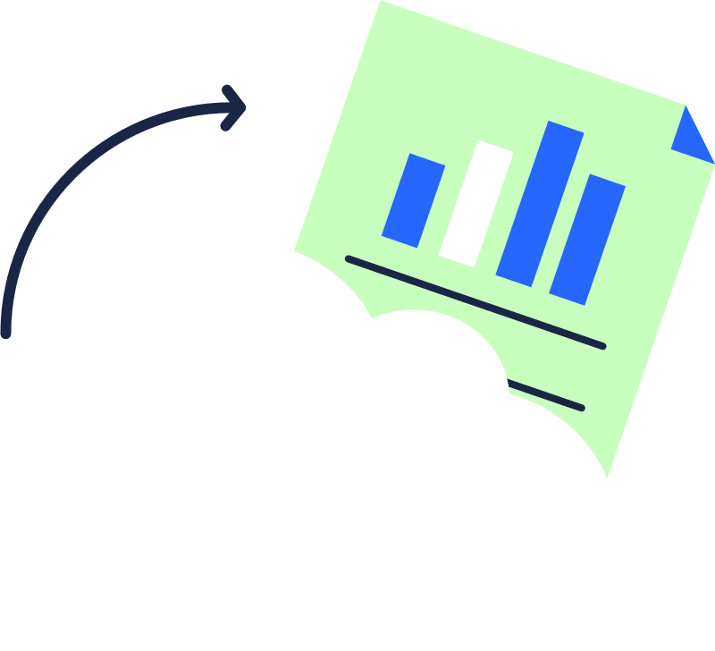

Back to Agenda
WHAT IS A BUBBLE-SORT NETWORK (BN)?
OVERVIEW | EXAMPLE
Bubble Sort is a simple sorting algorithm that repeatedly compares and swaps adjacent elements if they are in the wrong order. | Unsorted list: [5, 3, 1, 4] Step 1: [3, 1, 4, 5] Step 2: [1, 3, 4, 5] Sorted list: [1, 3, 4, 5]

Slide 9
An Independent Spanning Tree (IST) is a spanning tree that is structurally different from another spanning tree in the same graph. Two spanning trees are independent if the paths from any node to the root are disjoint except at the root.
Project Phase 01
Back to Agenda
WHAT IS INDEPENDENT SPANNING TREE ?

Slide 10
Constructing ist using bn
1234
2134
2314
2143
3214
2341
1243
3124
3241
2431
1324
3421
4231
2341
3412
4321
4213
3142
4312
4123
1342
4132
1423
1432

Slide 11
What will be path in this ist for 4213 to the root?
1234
2134
2314
2143
3214
2341
1243
3124
3241
2431
1324
3421
4231
2341
3412
4321
4213
3142
4312
4123
1342
4132
1423
1432

Slide 12
Constructing ist using bn
1234
2134
2314
2143
3214
2341
1243
3124
3241
2431
1324
3421
4231
2341
3412
4321
4213
3142
4312
4123
1342
4132
1423
1432

Slide 13
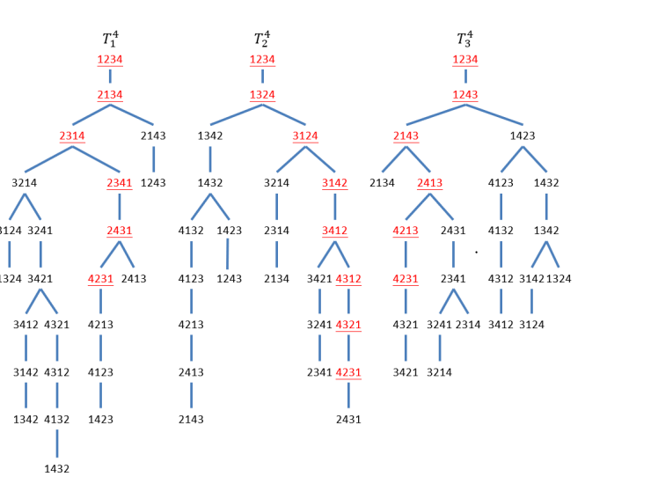
Constucting ist using bn

Slide 14
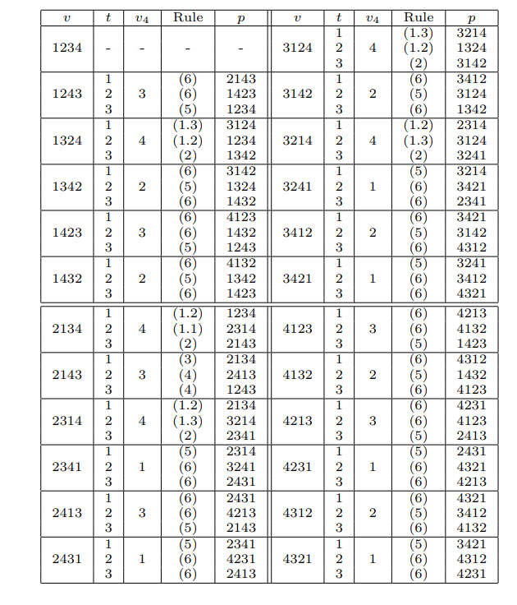
Constucting ist using bn

Slide 15
PROJECT PHASE 01
Contribution of the Paper
Presents a non-recursive algorithm for constructing n−1 ISTs in Bn.
Solves the parallelization problem of the previous recursive method.
Every vertex computes its parent in constant time.
Total time complexity: O(n * n!), which is asymptotically optimal.

Slide 16
Main Algorithm - Overview
 | 🔸 Algorithm 1: Parent1(v, t, n) 🔸 Input: vertex v, tree number t, network dimension n 🔸 Output: parent node of v in t-th tree 🔸 Uses simple swap operations to determine parent based on rules (1.1 to 6) 🔸 Pre-processing: Each vertex computes: - inverse permutation - first misplaced symbol (from right)
Project Phase 01

Slide 17
Algorithm Strategy (Parallelization)
Features | Description
Technique | Vertex-level parallelism
Unit of parallelism | Each vertex computes its parent independently
Time per vertex | Constant time O(1)
Total time complexity | O(n·n!) (for all vertices in all trees)
Frameworks mentioned | General parallel algorithm (not specific to MPI/OpenMP/OpenCL in this paper)

Slide 18



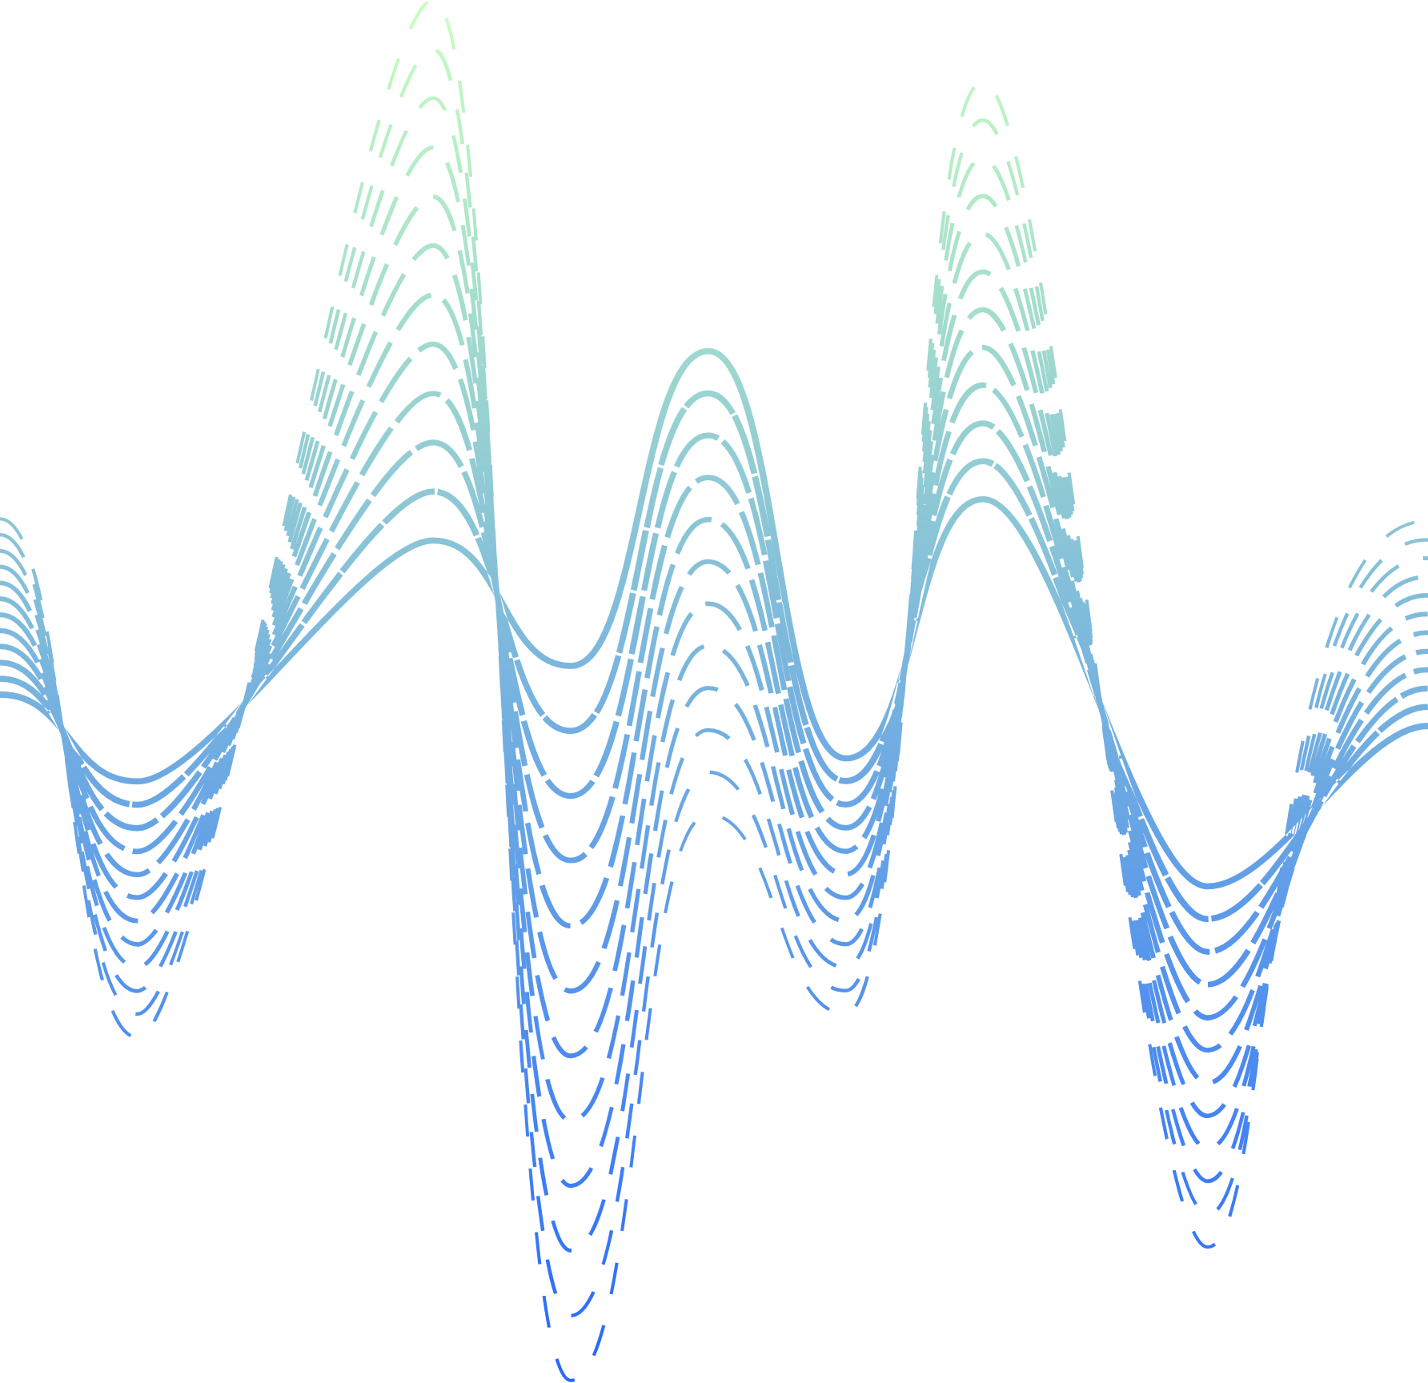
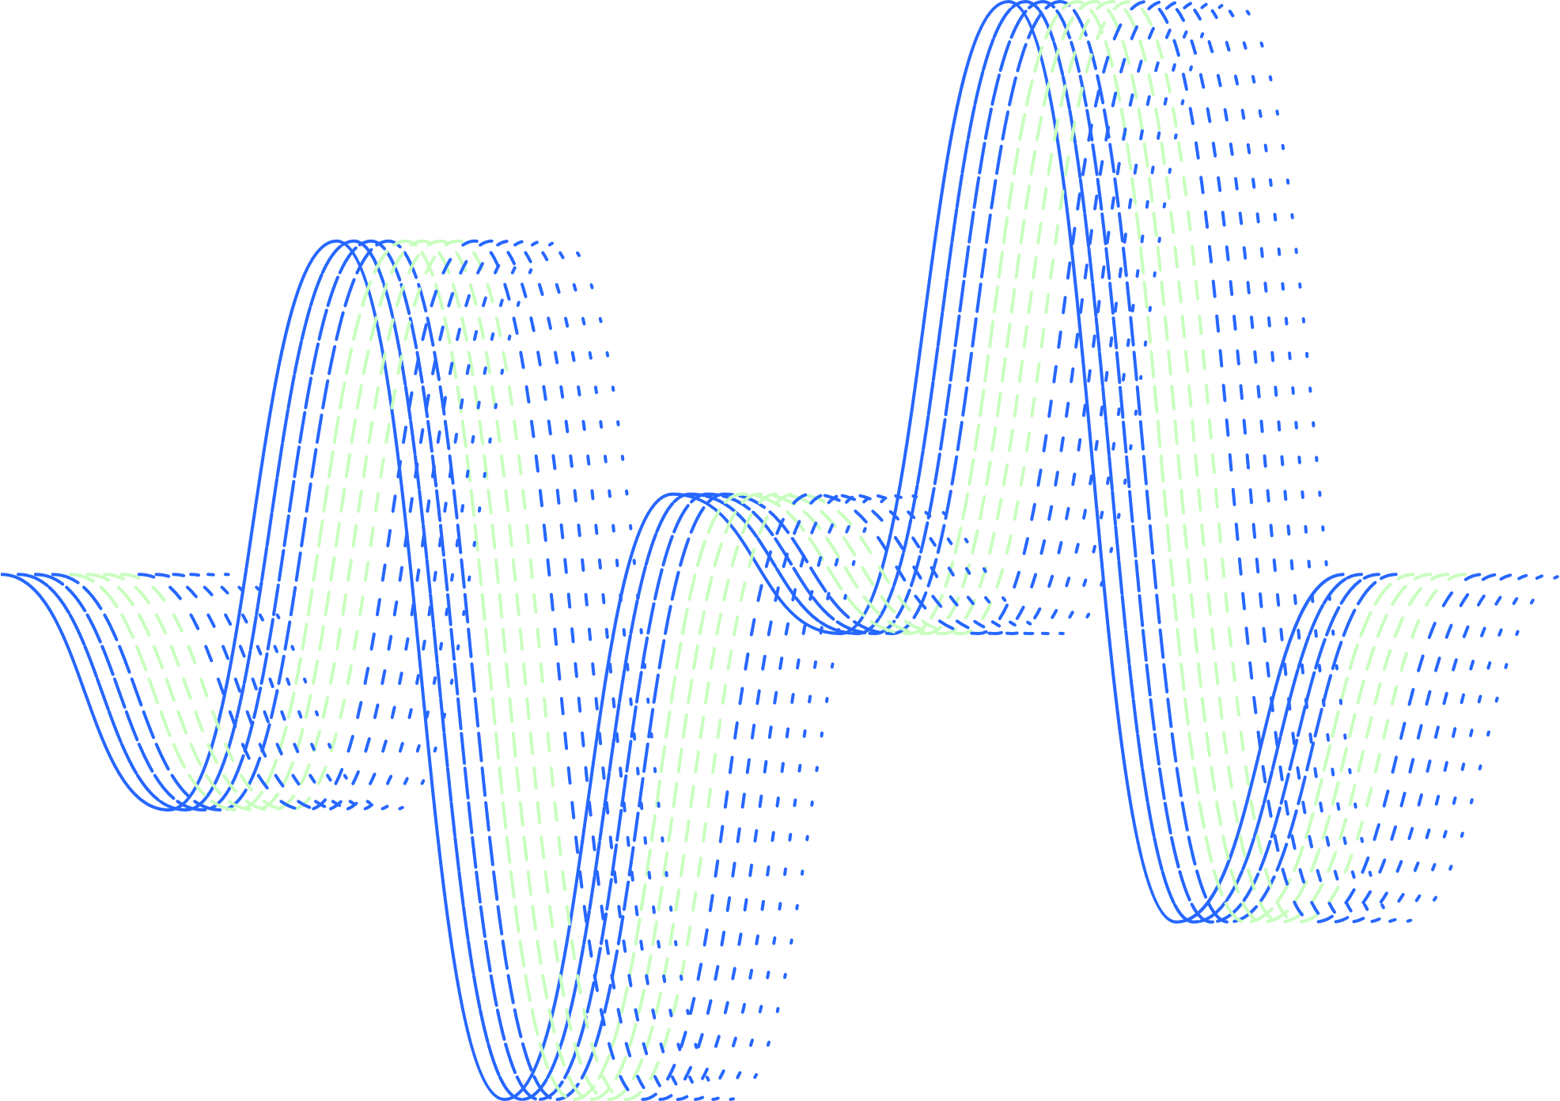
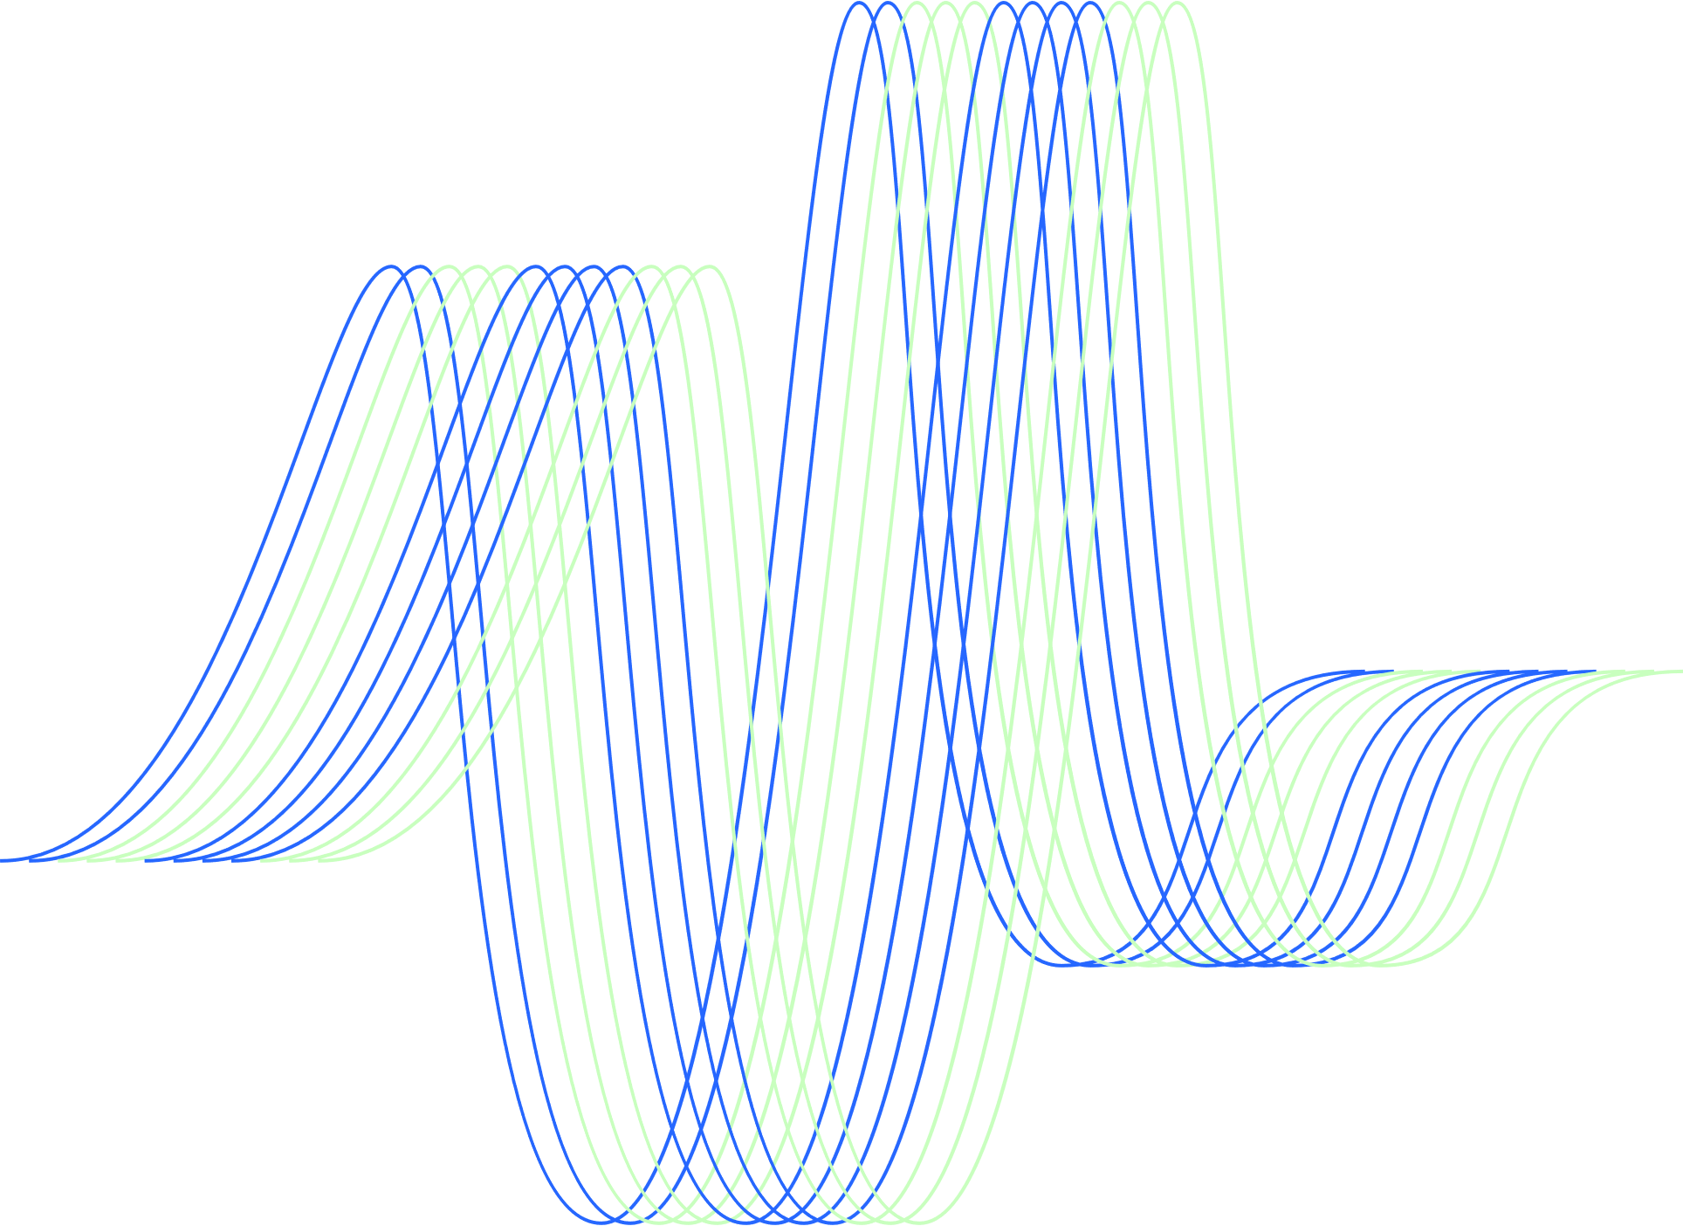

OpenMP
#pragma omp parallel for
for (int i = 0; i < factorial(n); ++i) {
parents[i] = Parent1(vertices[i], t, n);
}

Slide 19
METIS
Challenge:
Distribute the computation of parent nodes across processors while minimizing inter-processor communication
Solution:
Utilize METIS, a graph partitioning tool, to divide the Bn graph into balanced partitions:
Implementation Steps:
Graph Generation: Represent Bn as a graph where nodes are permutations and edges represent adjacent swaps.
Partitioning with METIS: Apply METIS to partition the graph into k parts.
Parallel Processing: Assign each partition to a processor to compute parent nodes using the Parent1(v, t, n) algorithm.

Slide 20





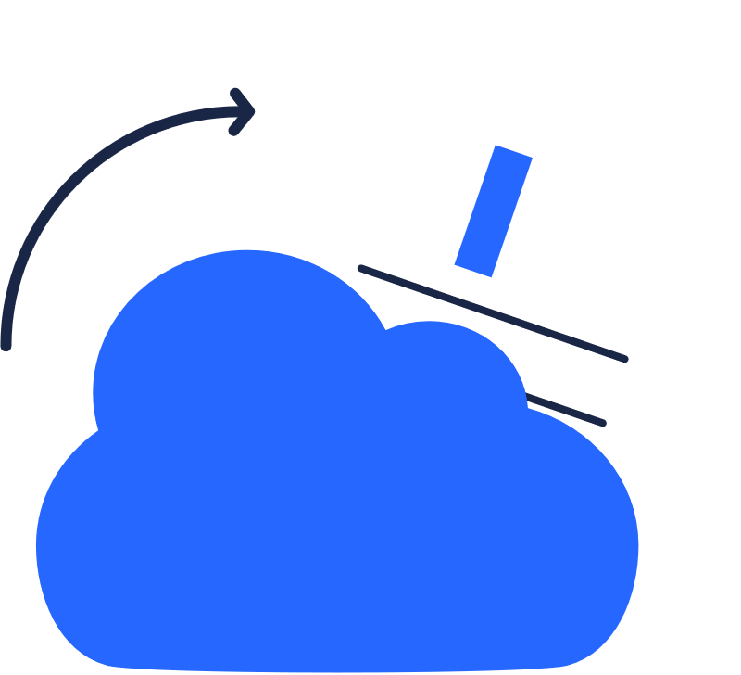









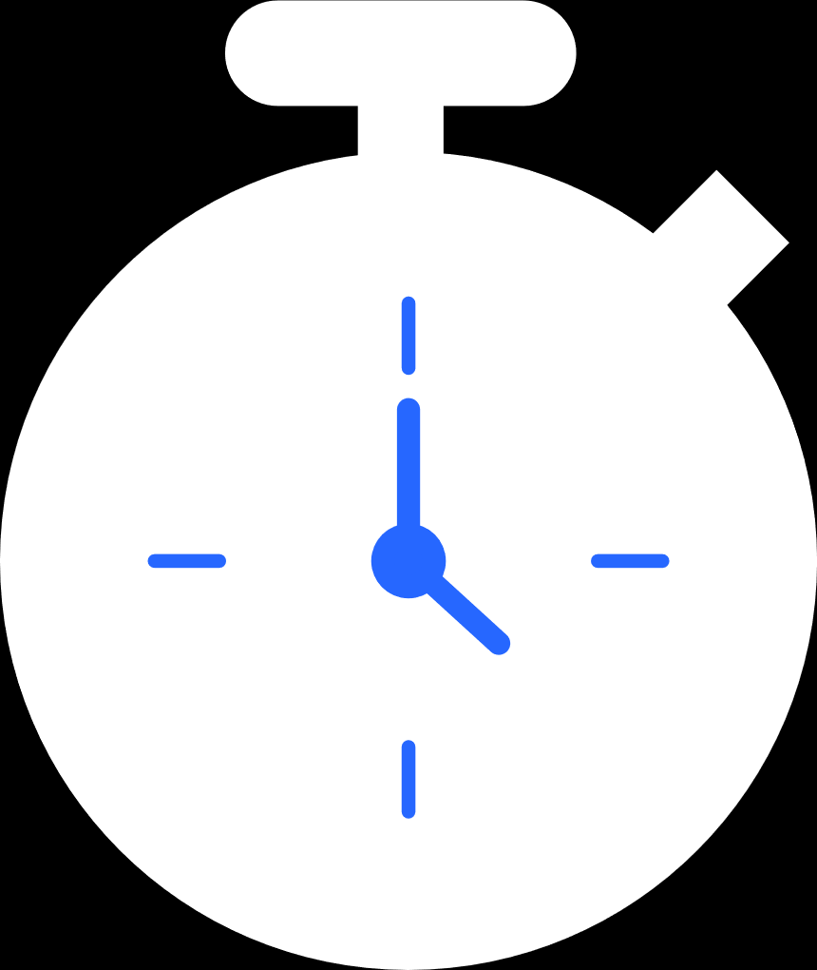
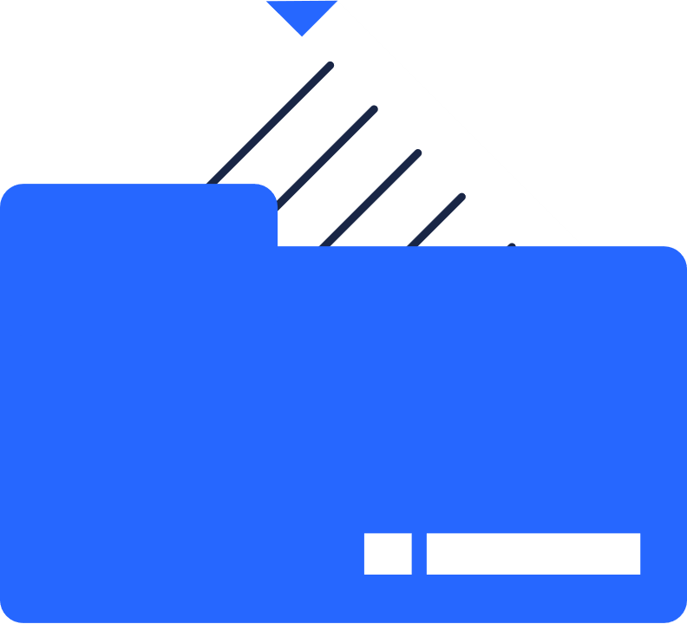



Time and Space Complexity
⏱ Time Complexity:
- Per node per tree = O(1)
- Total = O(n * n!) for all trees and nodes
💾 Space:
- Local information (position, permutation) only.

Slide 21
Scalability
📊 Can handle large networks due to parallel computation.
✔️ Suitable for real-world MPI clusters.
✔️ Performance improves with graph size using METIS for partitioning.

Slide 22
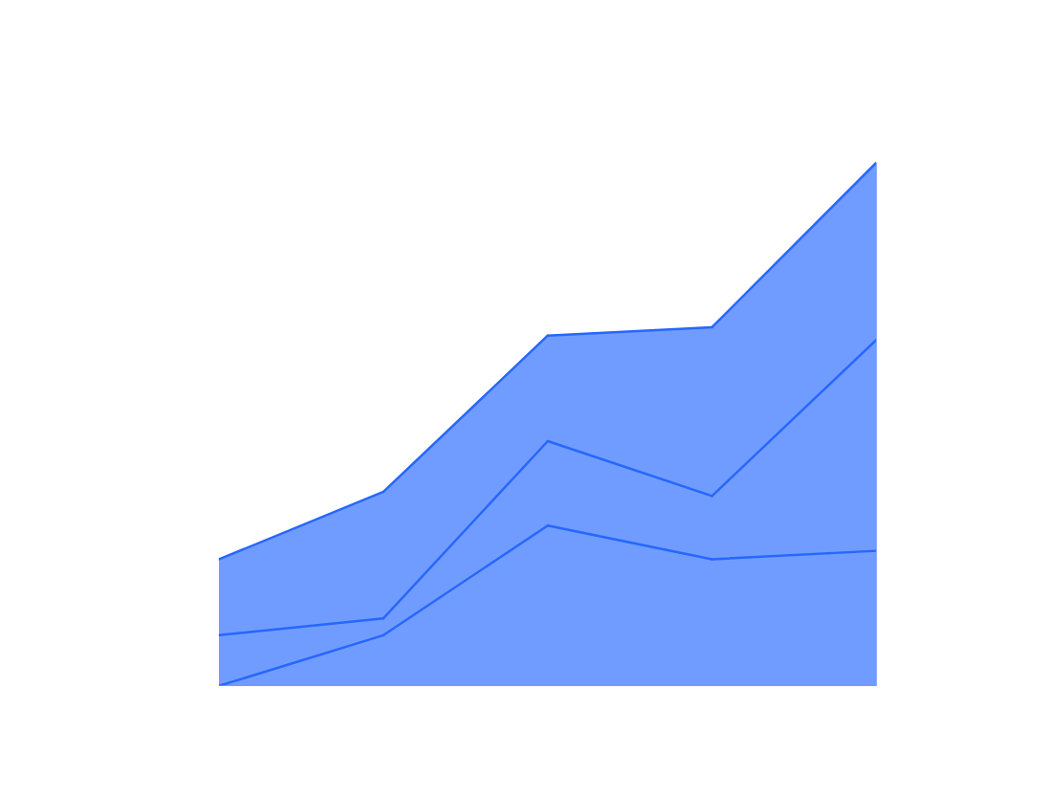
Project Phase 01
RESULTS AND ANALYSIS
The Bn graph demonstrates efficient topology for parallel computing due to its high symmetry, predictable structure, and fault-tolerant characteristics, making it suitable for modeling interconnection networks.
Back to Agenda
Back to Agenda

Slide 23
Conclusion
Fully parallelizable – each node finds its parent in constant time.
Proposed an algorithm to construct n−1 Independent Spanning Trees (ISTs) in Bubble-Sort Network Bₙ.
Time complexity: O(n · n!), proven to be asymptotically optimal.
Bₙ is regular with connectivity n−1, allowing maximum ISTs.
Future work:
Extend the method to (n, k)-bubble-sort graphs.
Explore IST construction in butterfly graphs with similar structure.

Slide 24
Project Phase 01
Back to Agenda
THANK YOU

